Slide 1

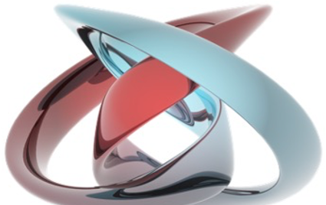
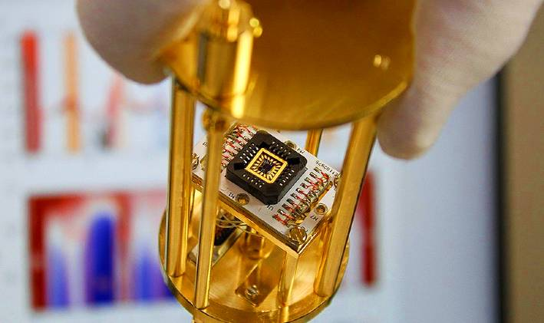
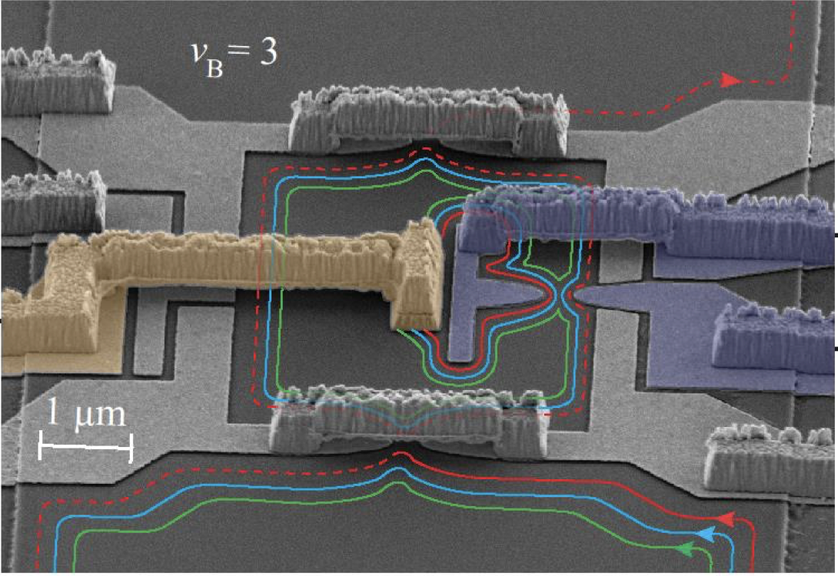
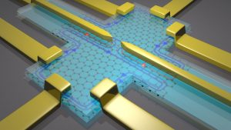
Laboratory of Quantum Physics: Topology and Correlations
Quantum transport in Mesoscopic systems
(PHYS-462)
Ref: arXiv:2009.10985v2

Slide 2
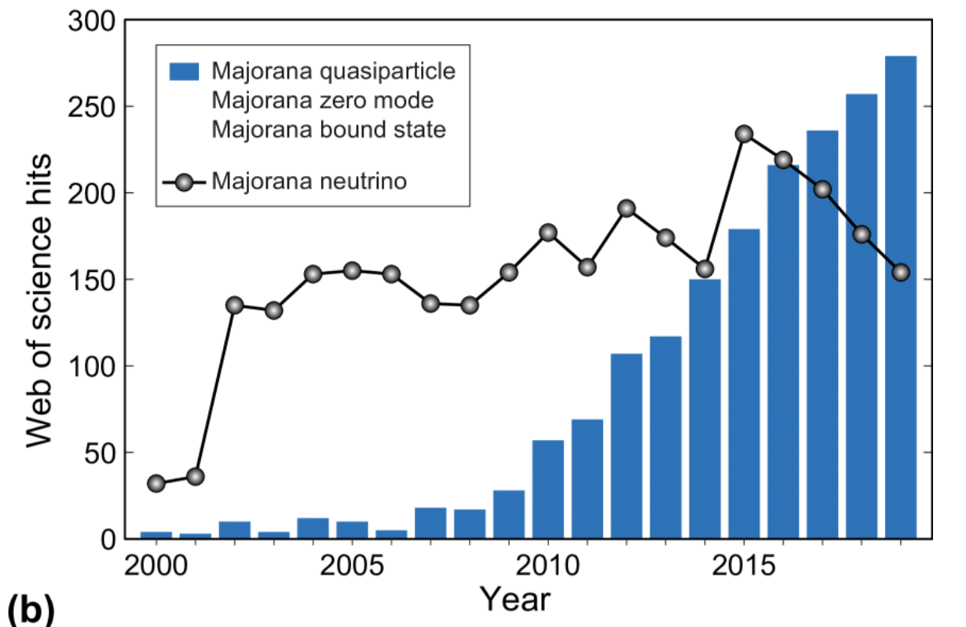
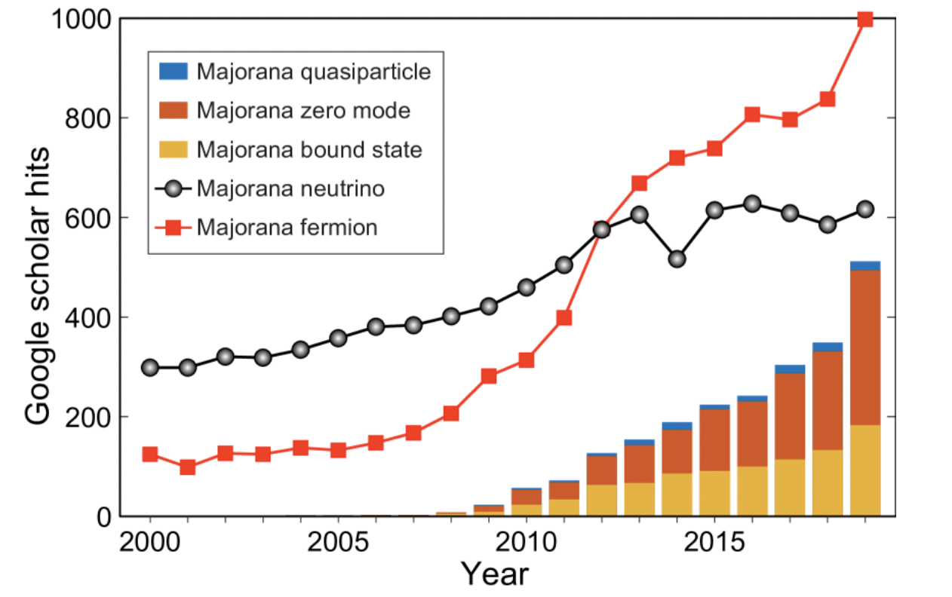
Majorana in 1D systems
Majorana zero-modes have been intensively studied in recent years owing to their potential application in fault-tolerant quantum computing. There have already been many review papers about Majorana, mainly on Majorana theories. This is a list of recent experimental developments of one-dimensional Majorana devices, aiming to give a comprehensive overview and understanding of one-dimensional Majorana experiments.

Slide 3
Bound states
The formation of the Majorana zero-mode is a consequence of a phase transition with a change in band topology.
Last week, we learned that a semiconductor-superconductor hybrid nanowire is a possible Majorana platform. To create Majorana zero-modes in such a system, semiconductor nanowires with large spin-orbit interactions are electronically contacted to superconductors. Besides the spin-orbit field, an external magnetic field (from a ferromagnet or a coil) is also required to break the time-reversal symmetry.
Electrons in low-dimensional systems are strongly confined, and the confinements give rise to discrete levels with quantized energies. To distinguish these confined states from their superconducting counterparts, we will refer to them as normal bound states. Just as the word “bound” indicates, the particles occupying these bound states are coherently bounced back and forth by the system boundaries.
In a superconductor-normal conductor hybrid system, the so-called Andreev reflection, instead of the normal reflection, occurs when a low-energy incident particle (or hole) travels from the normal conductor into the superconductor. Because of the lack of available states in the superconductor gap E<|±Δ|, the incident particle (hole) cannot directly propagate into the superconductor. Consequently, the superconductor will retro-reflect (Andreev reflection) a time-reversed hole (particle) with opposite momentum and spin into the normal conductor. In this way, the superconductor gains (loses) a Cooper pair from (to) the normal conductor. Electron states confined by Andreev reflection are hence called Andreev bound states, which are essentially the extension of the superconducting pairing potential Δ(r) out of the superconductor.

Slide 4
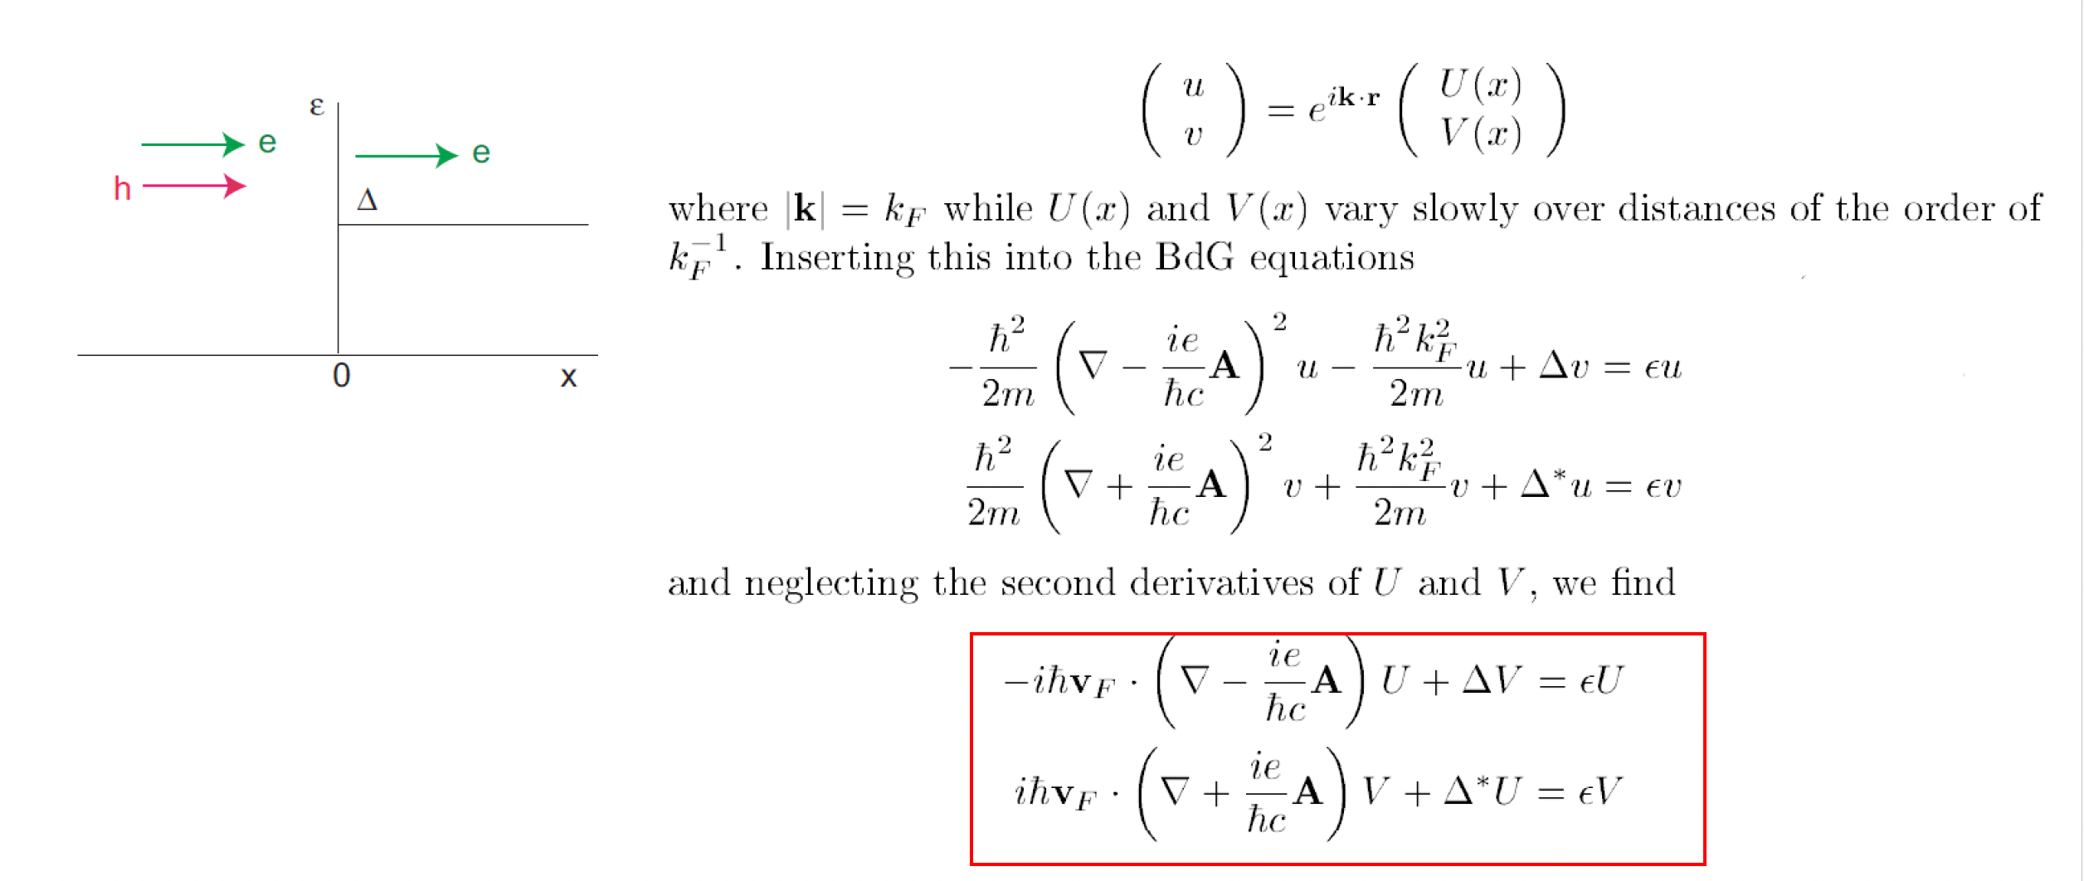
Andreev reflection

Slide 5
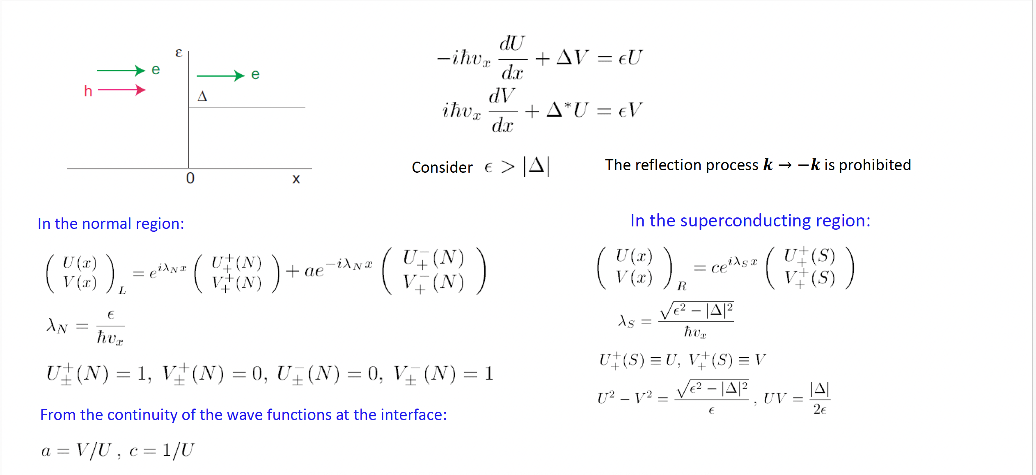
Andreev reflection

Slide 6
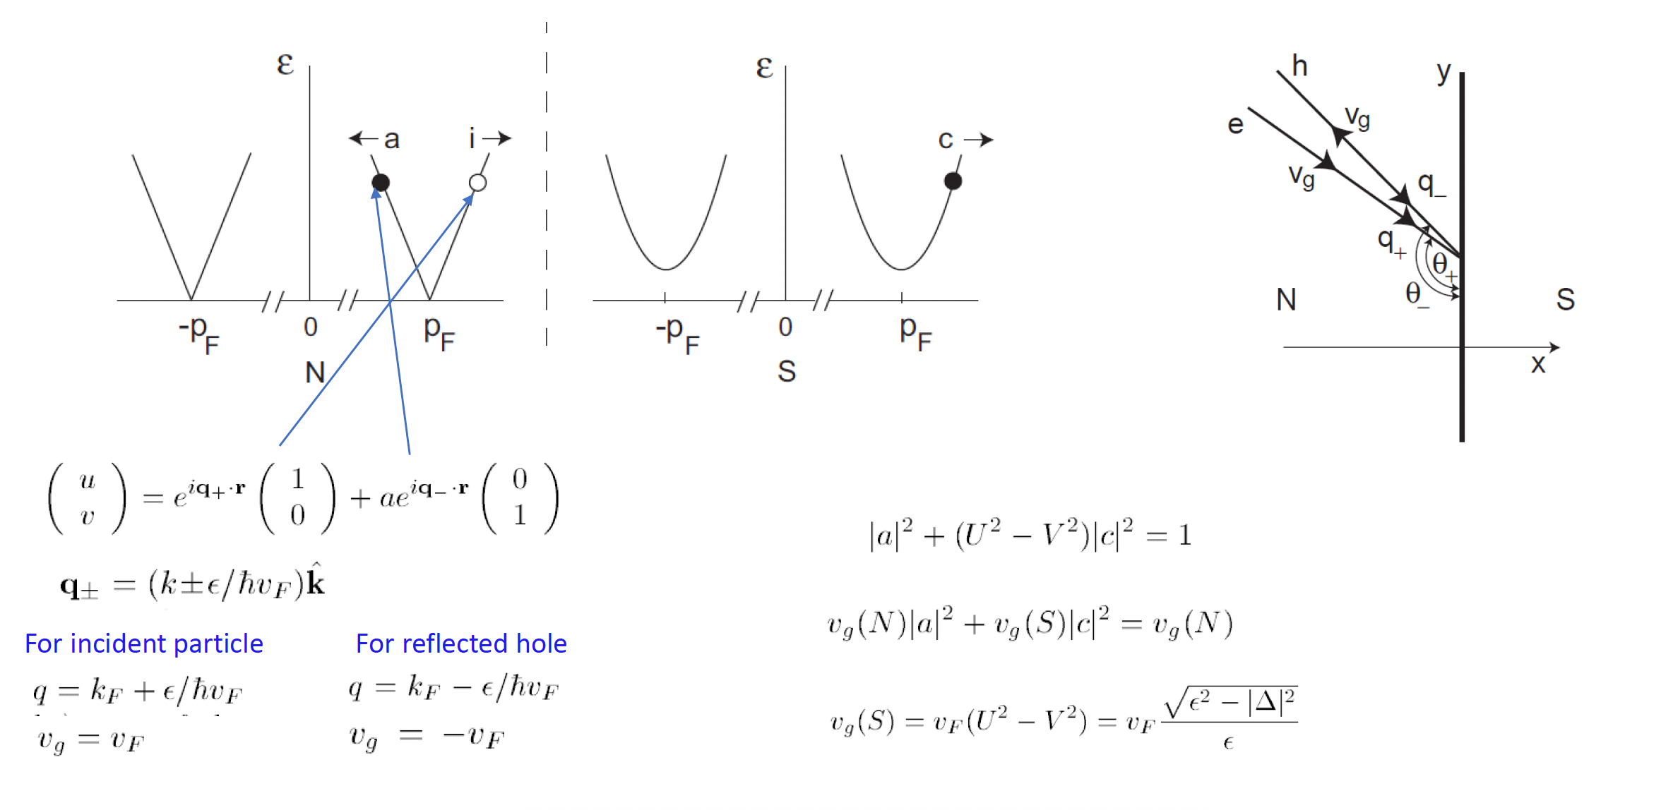
Andreev reflection

Slide 7
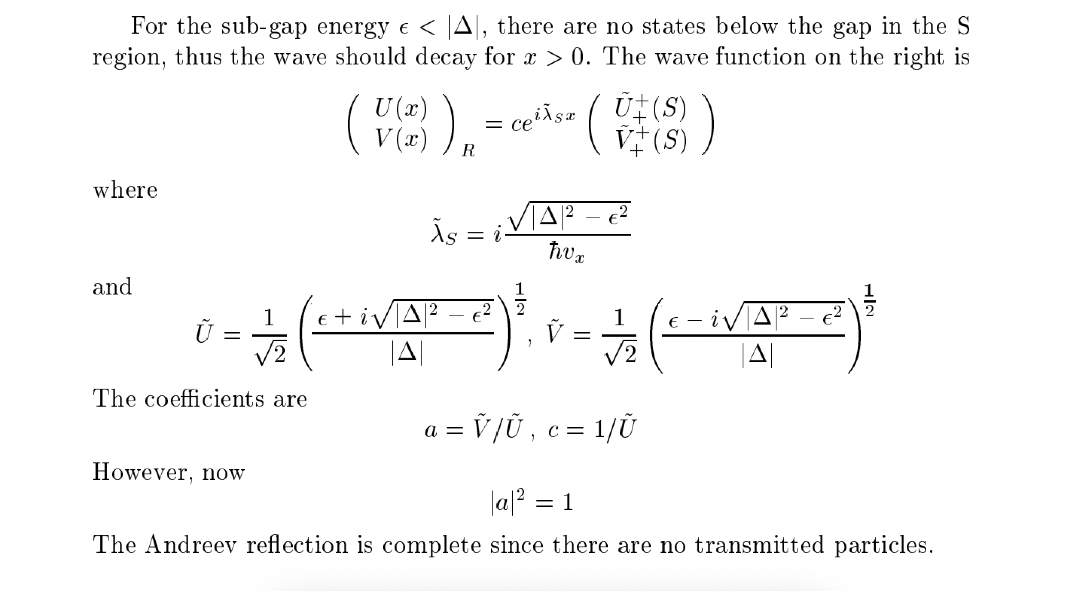
Andreev reflection

Slide 8
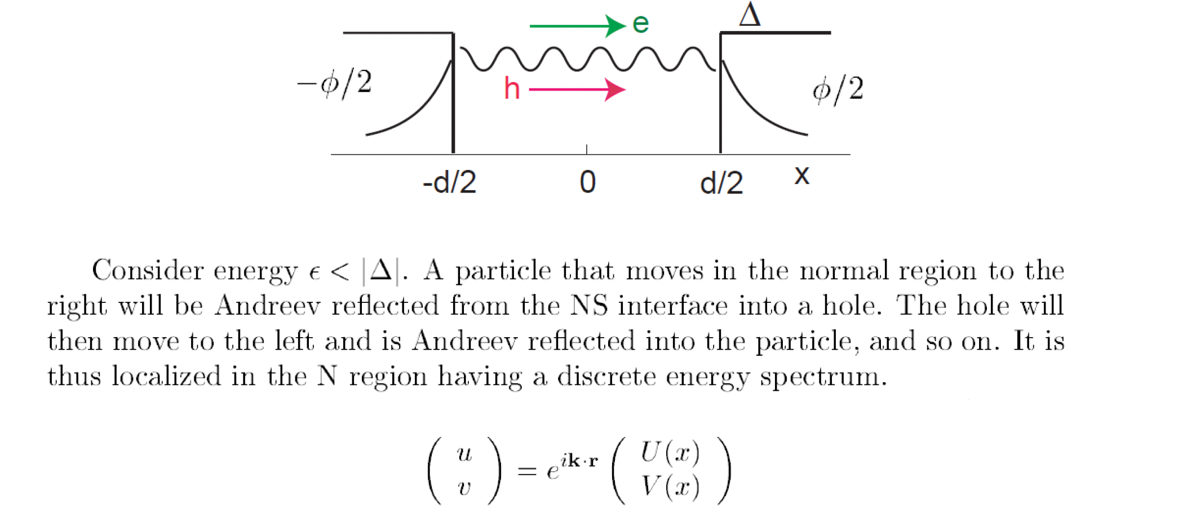
Andreev states in SNS structure

Slide 9
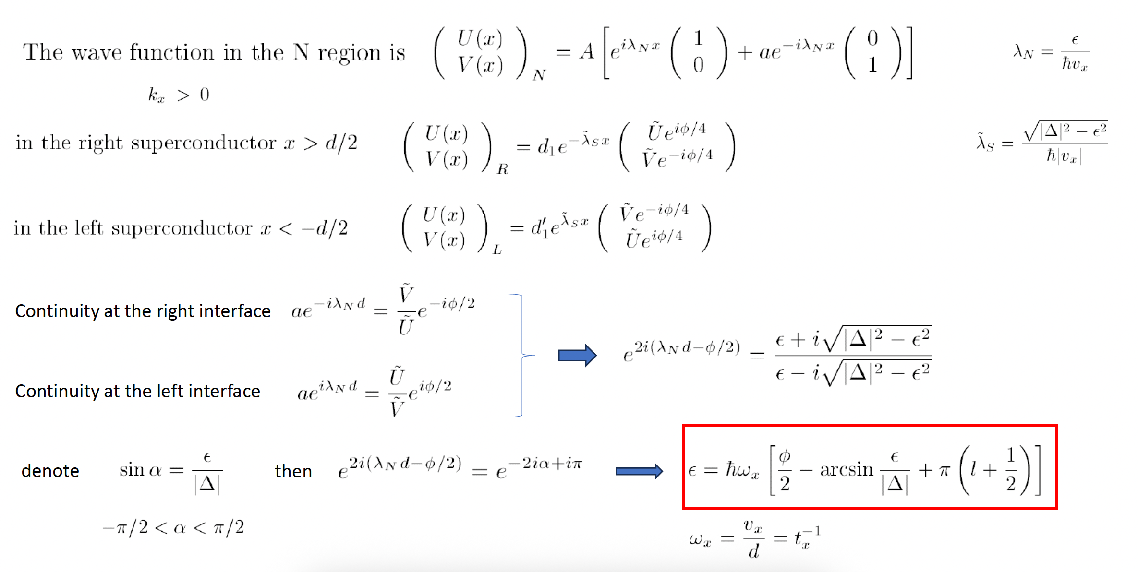
Andreev states in SNS structure

Slide 10
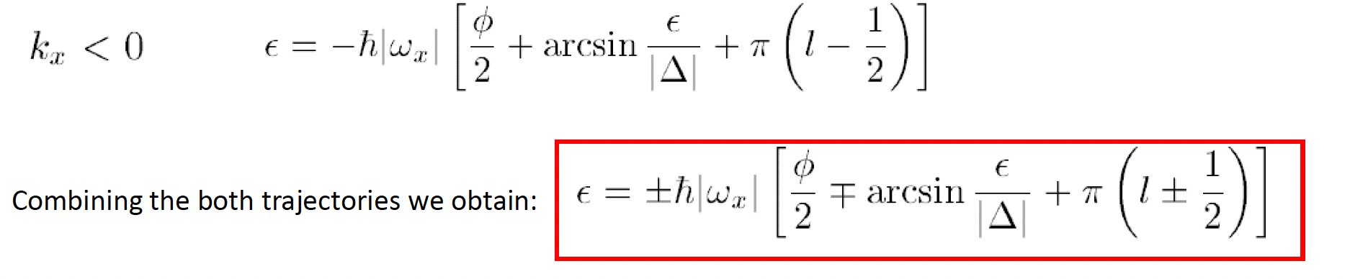
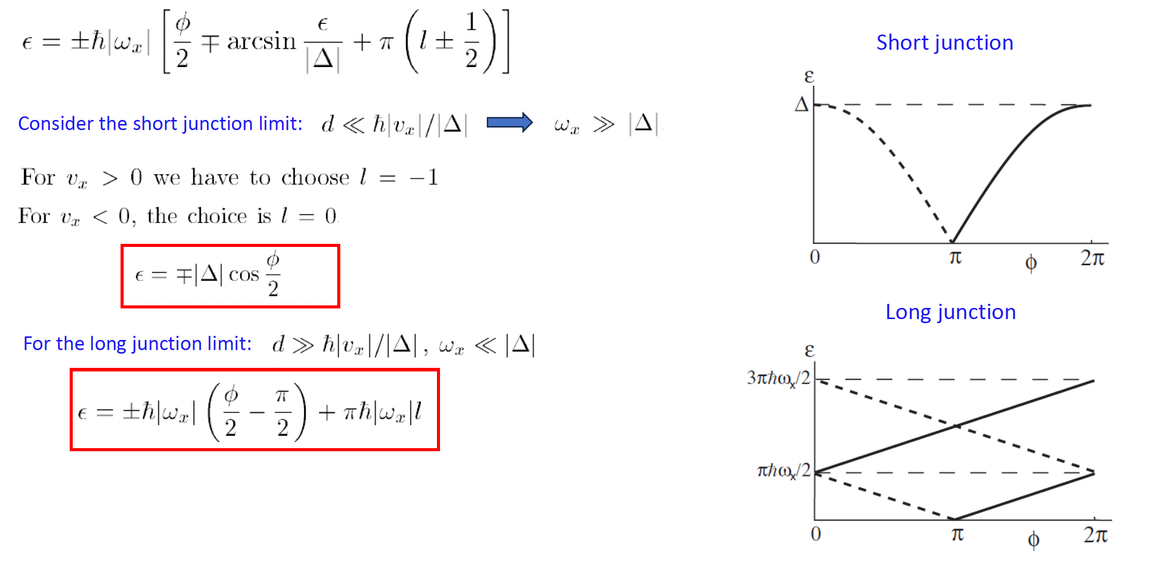
Andreev states in SNS structure

Slide 11
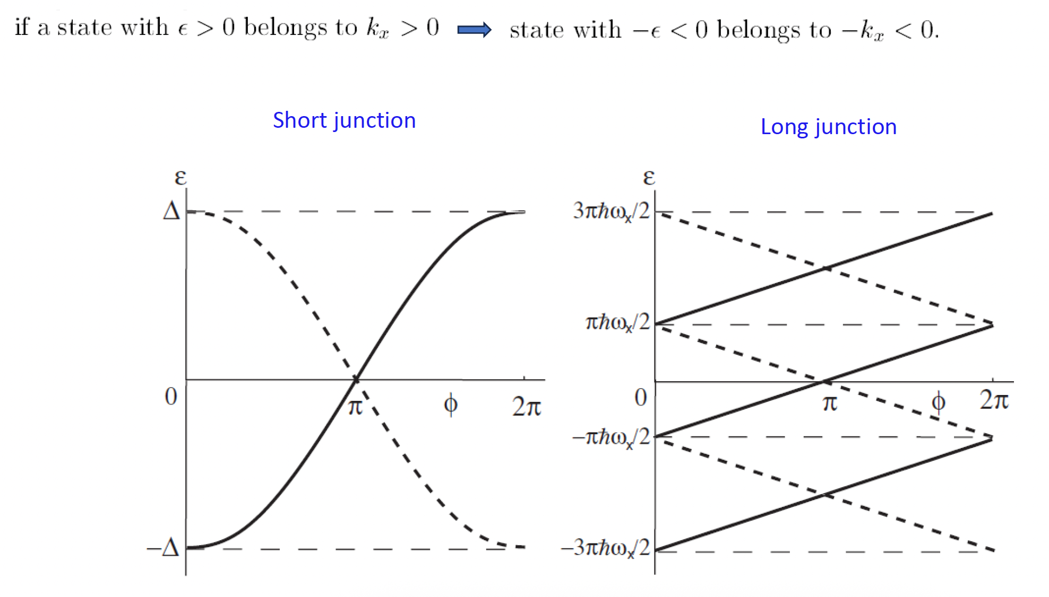
Andreev states in SNS structure

Slide 12
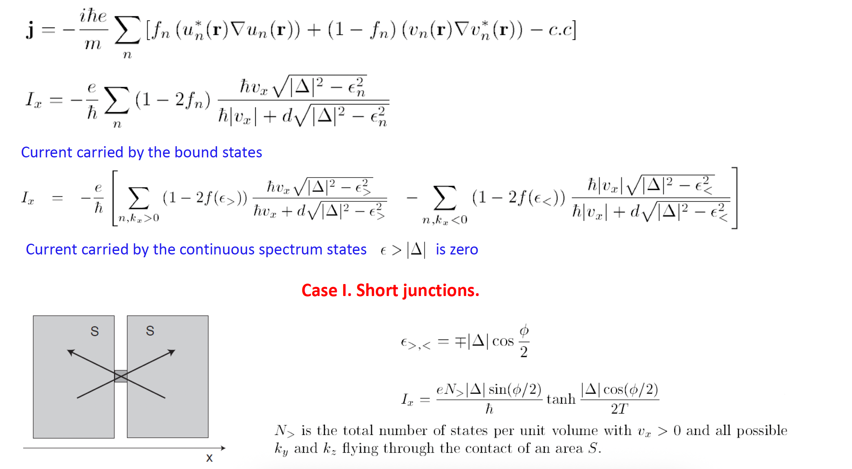
Andreev states: supercurrent through SNS

Slide 13
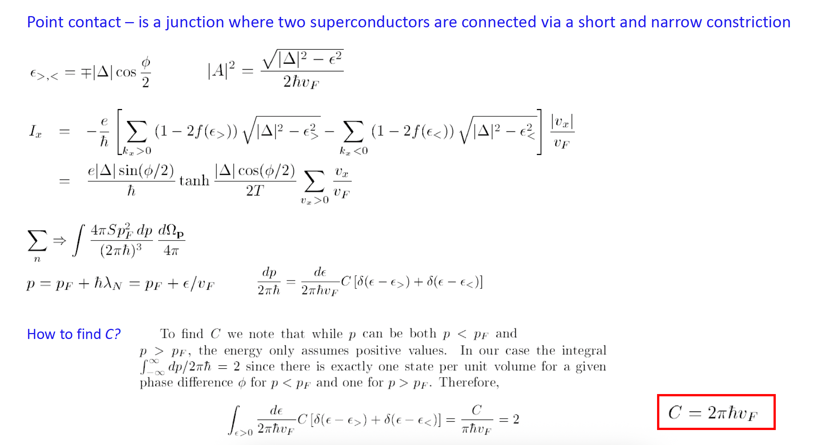
Andreev states: supercurrent through SNS

Slide 14
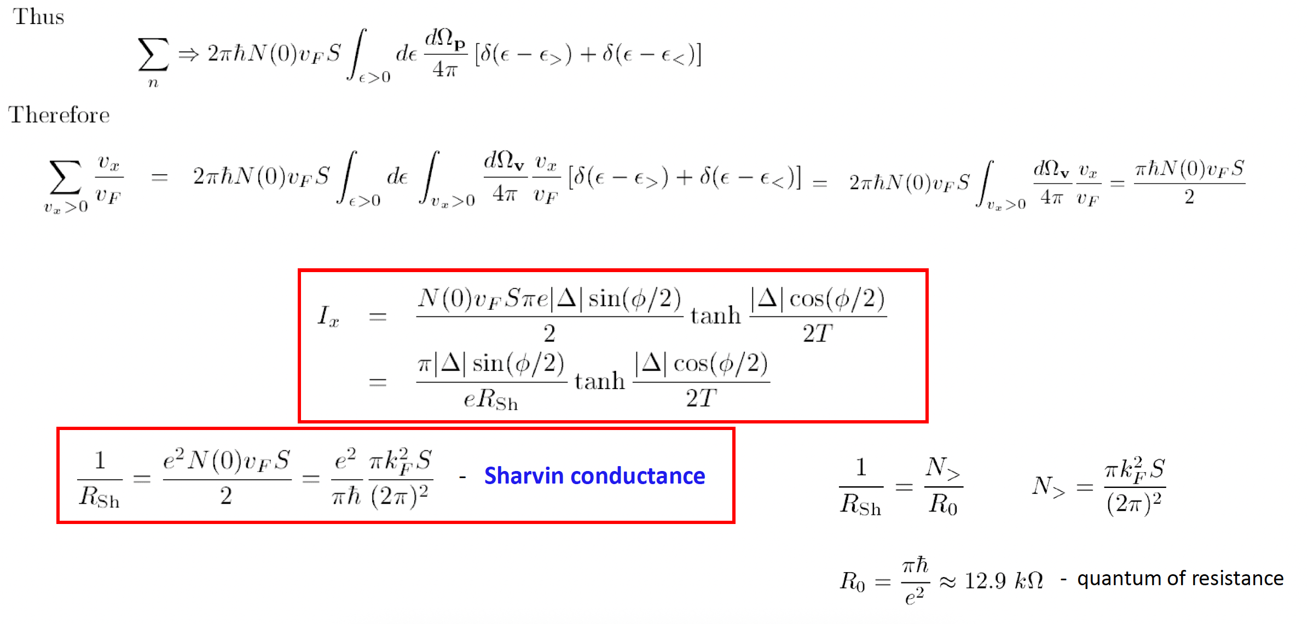
Andreev states: supercurrent through SNS

Slide 15
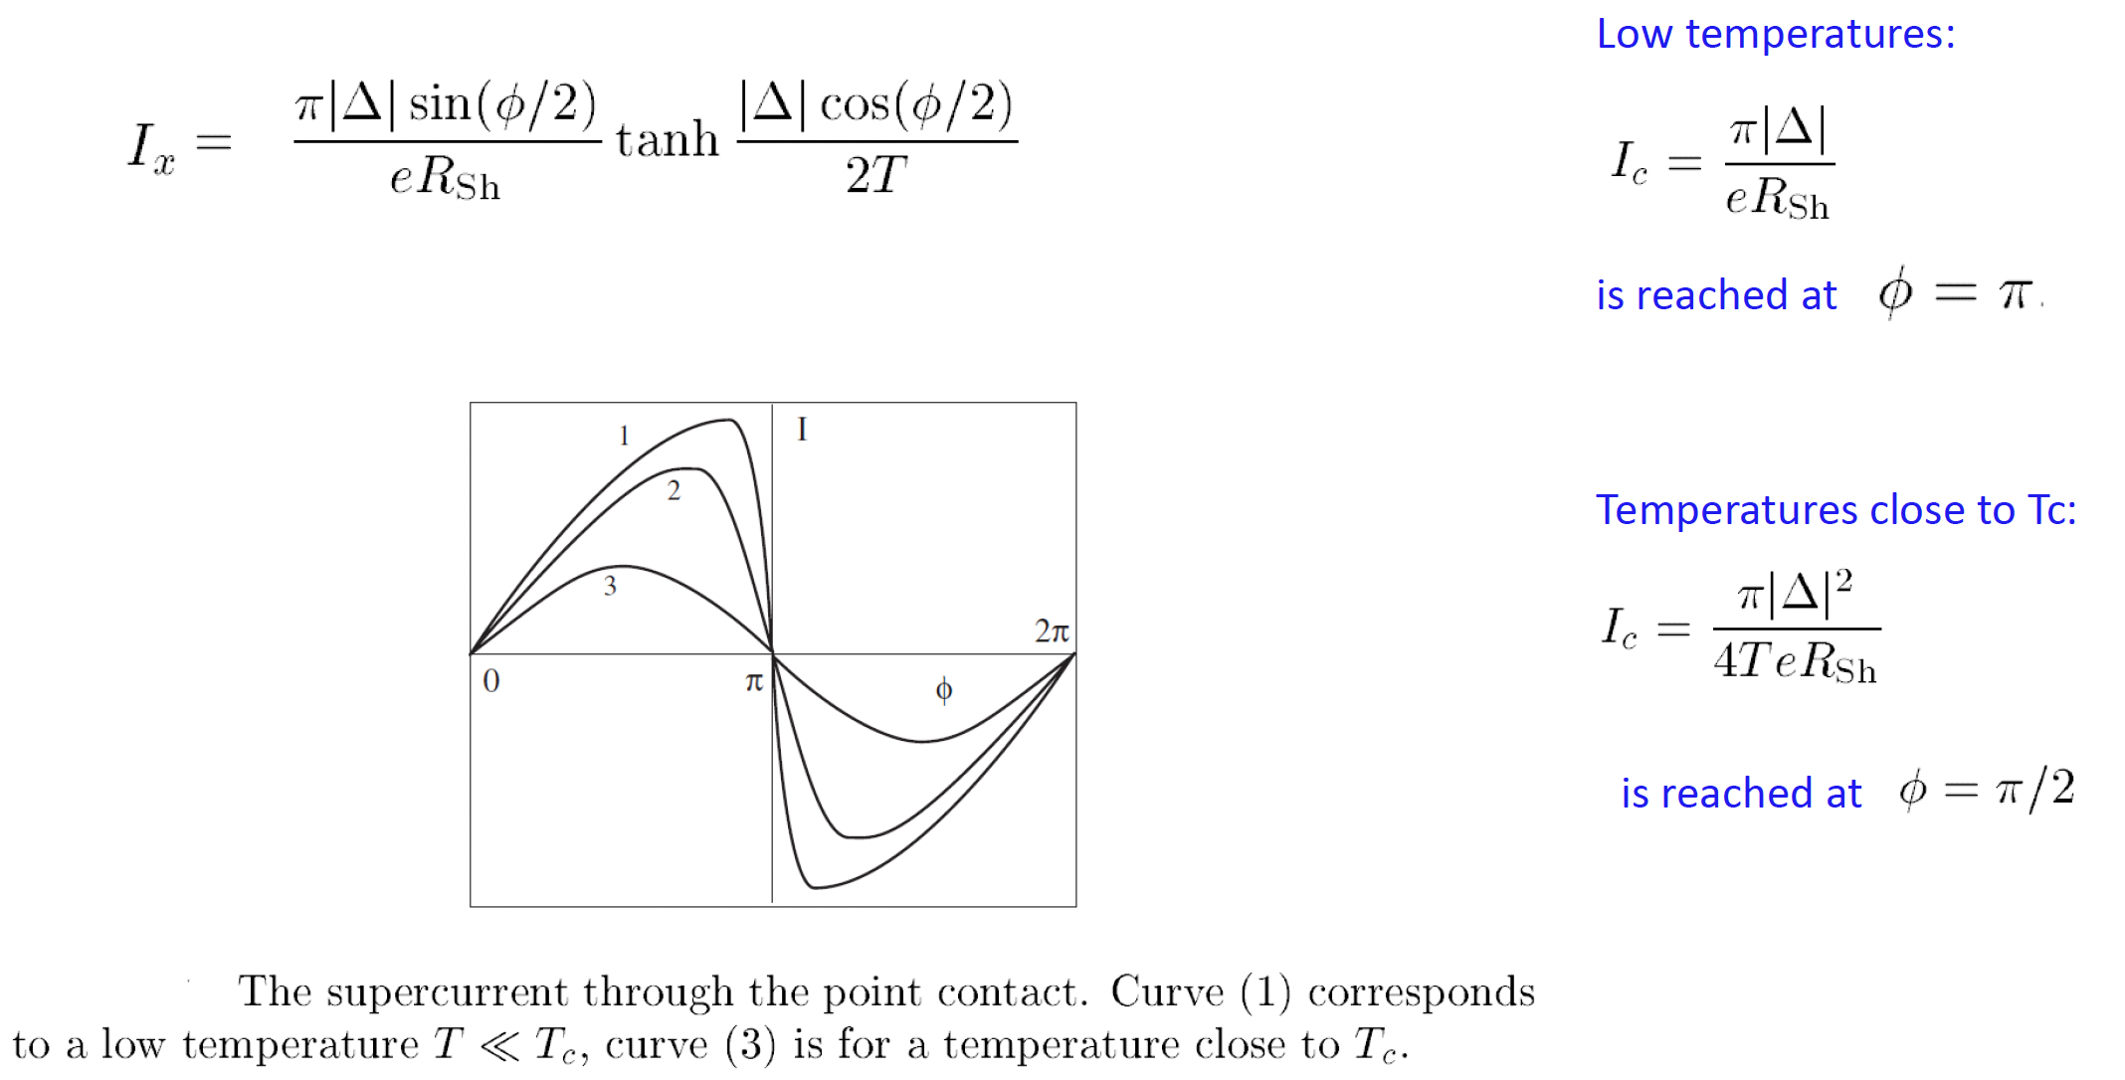
Andreev states: supercurrent through SNS

Slide 16
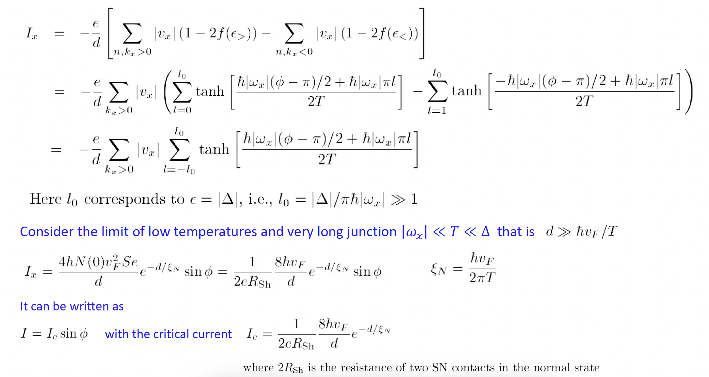
Andreev states: supercurrent through SNS
Case 2: Long junctions.

Slide 17
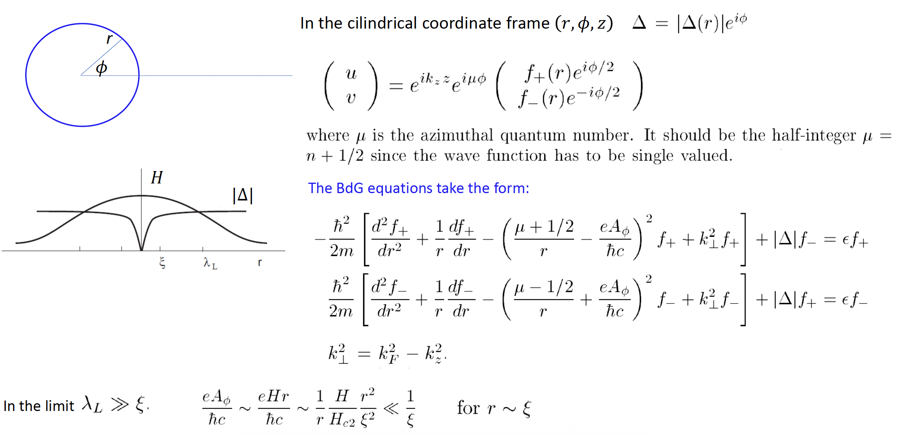
Andreev states: vortex core states

Slide 18
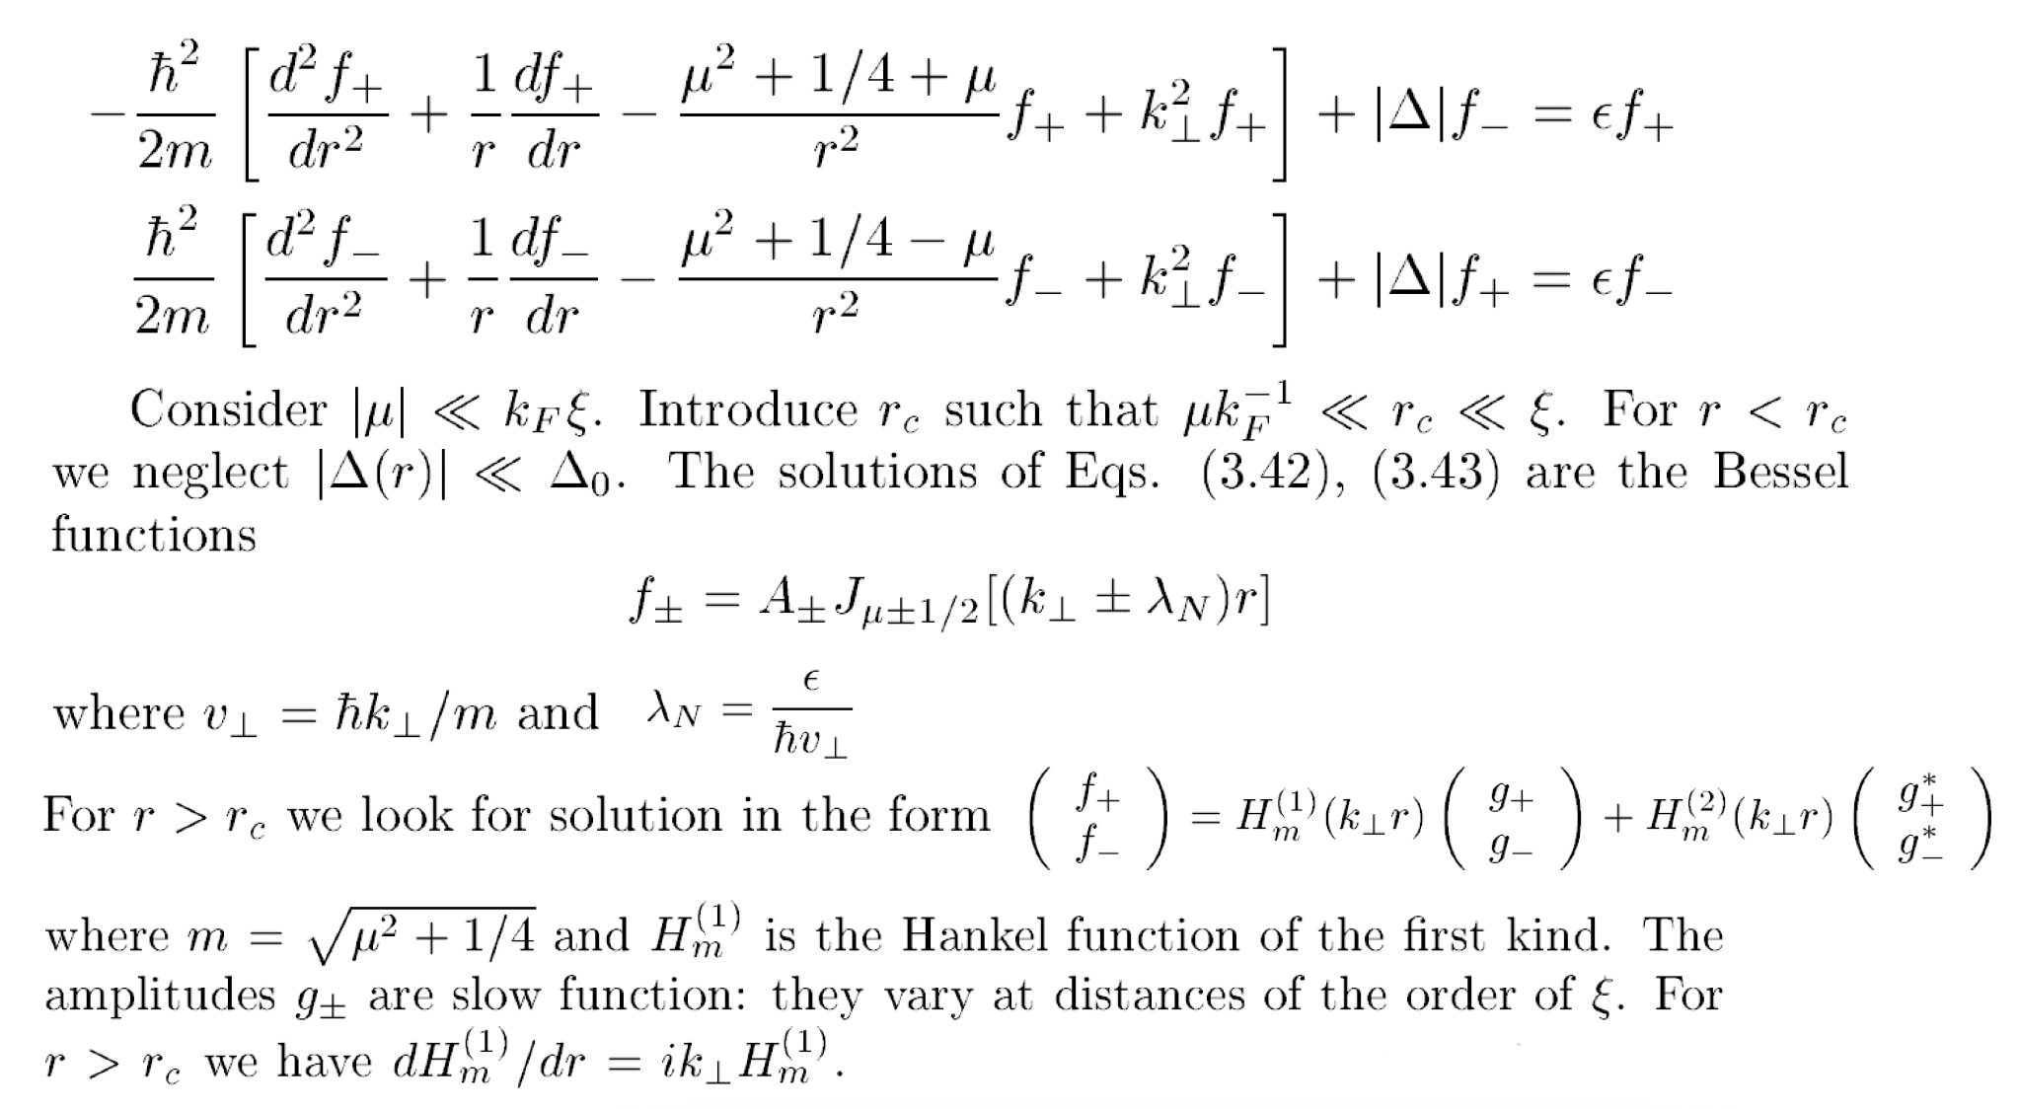
Andreev states: vortex core states

Slide 19
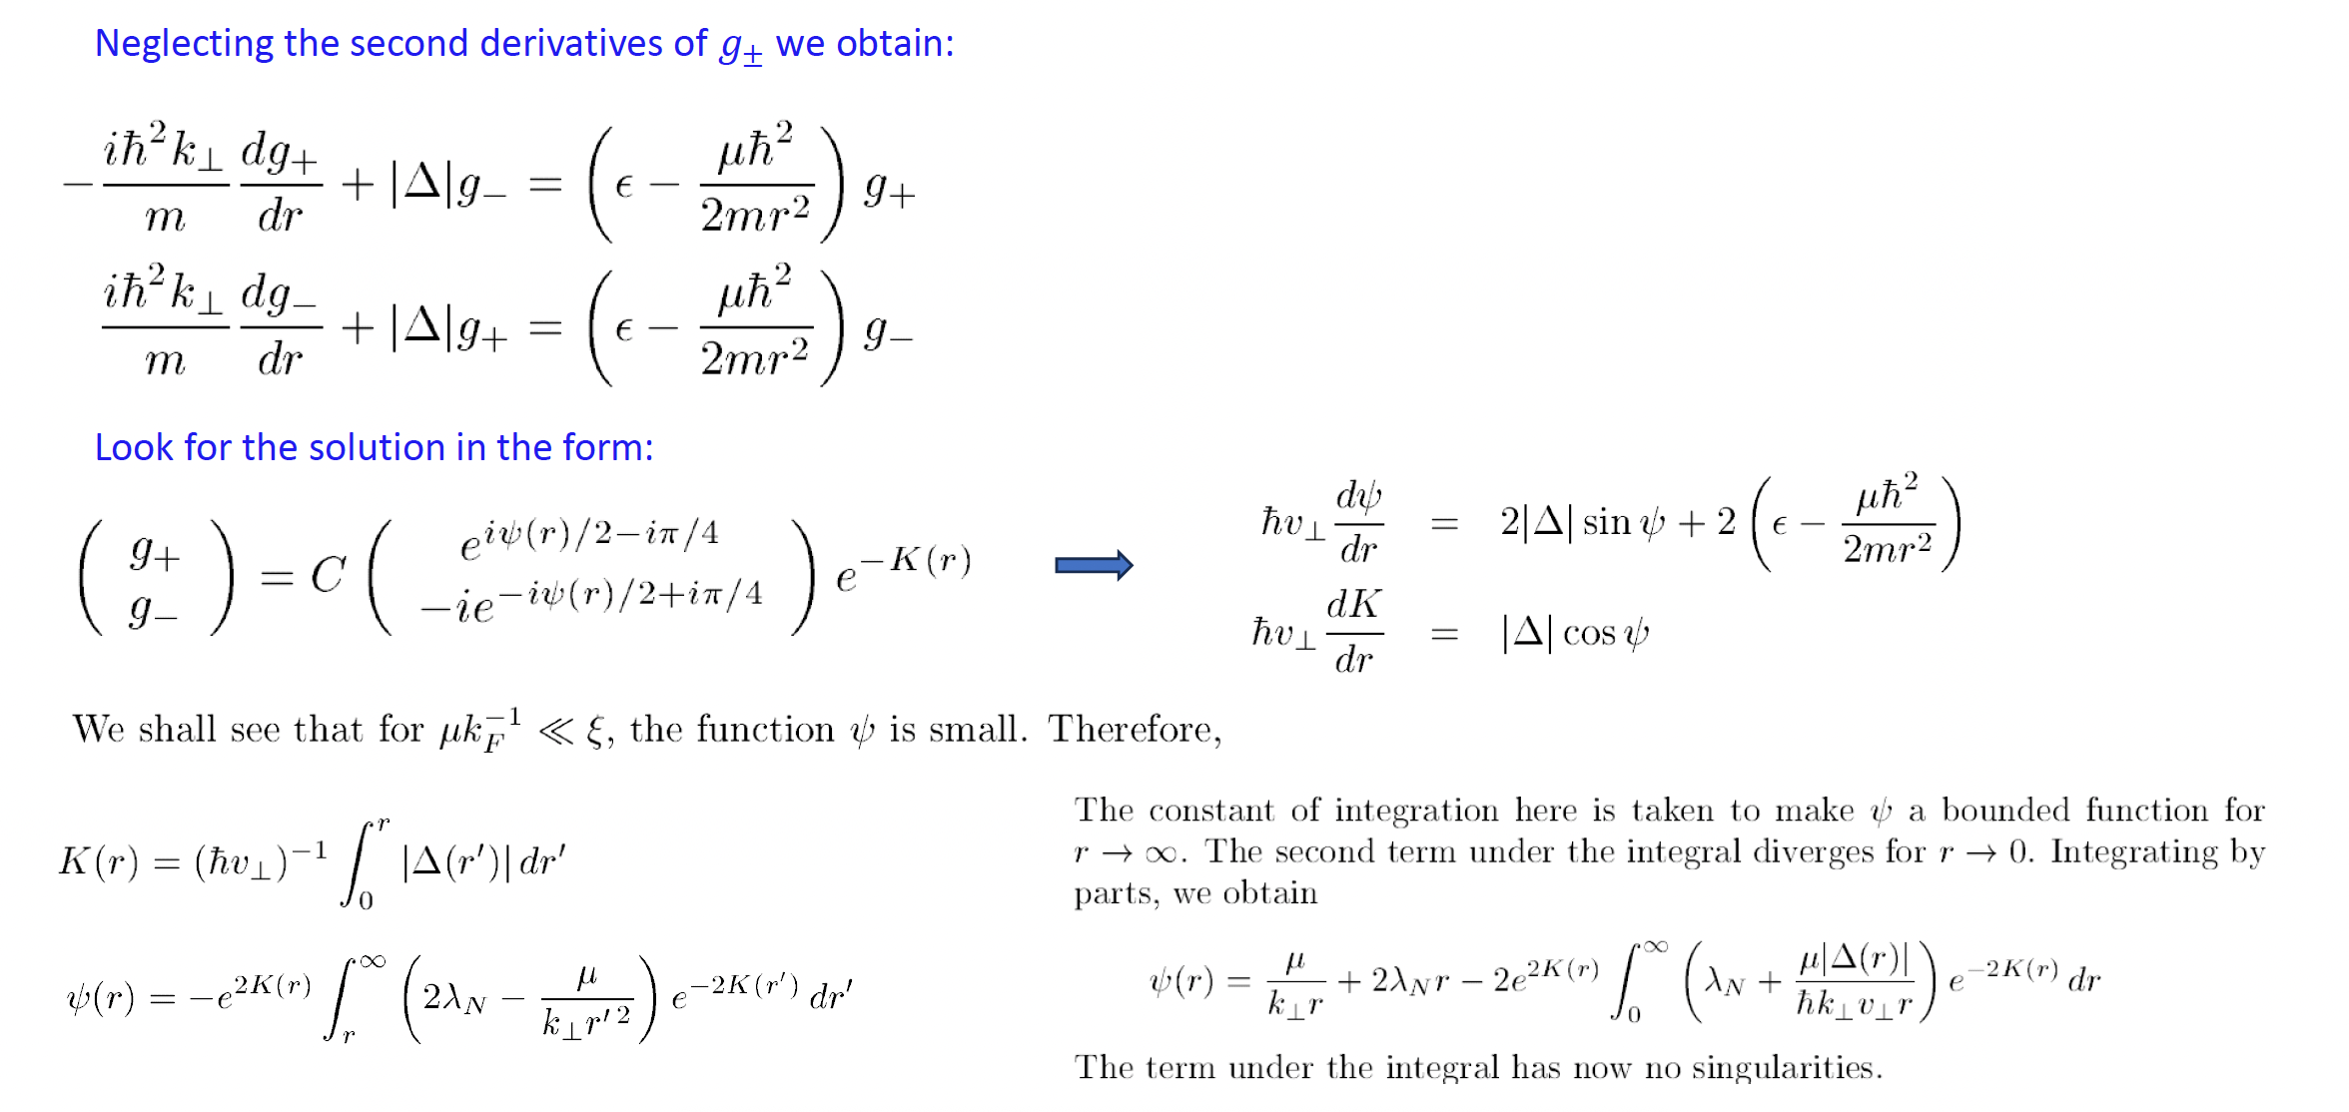
Andreev states: vortex core states

Slide 20
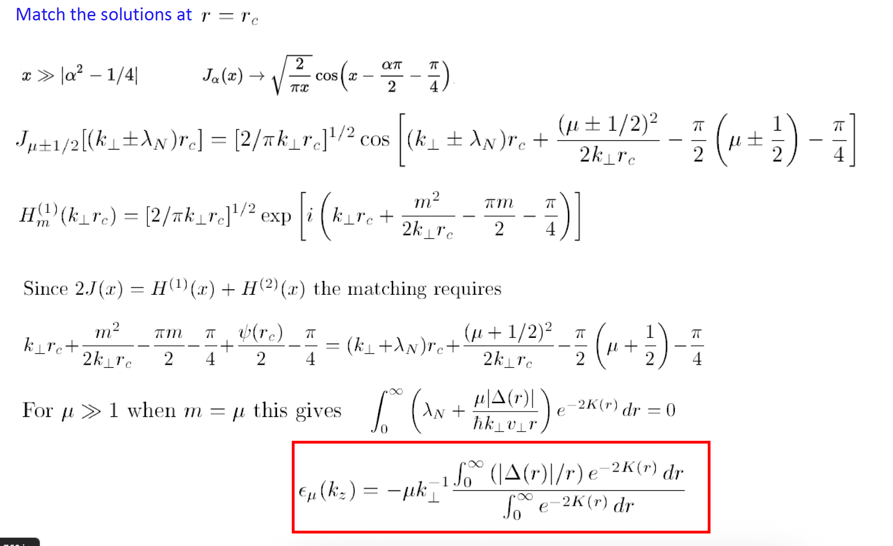
Andreev states: vortex core states

Slide 21
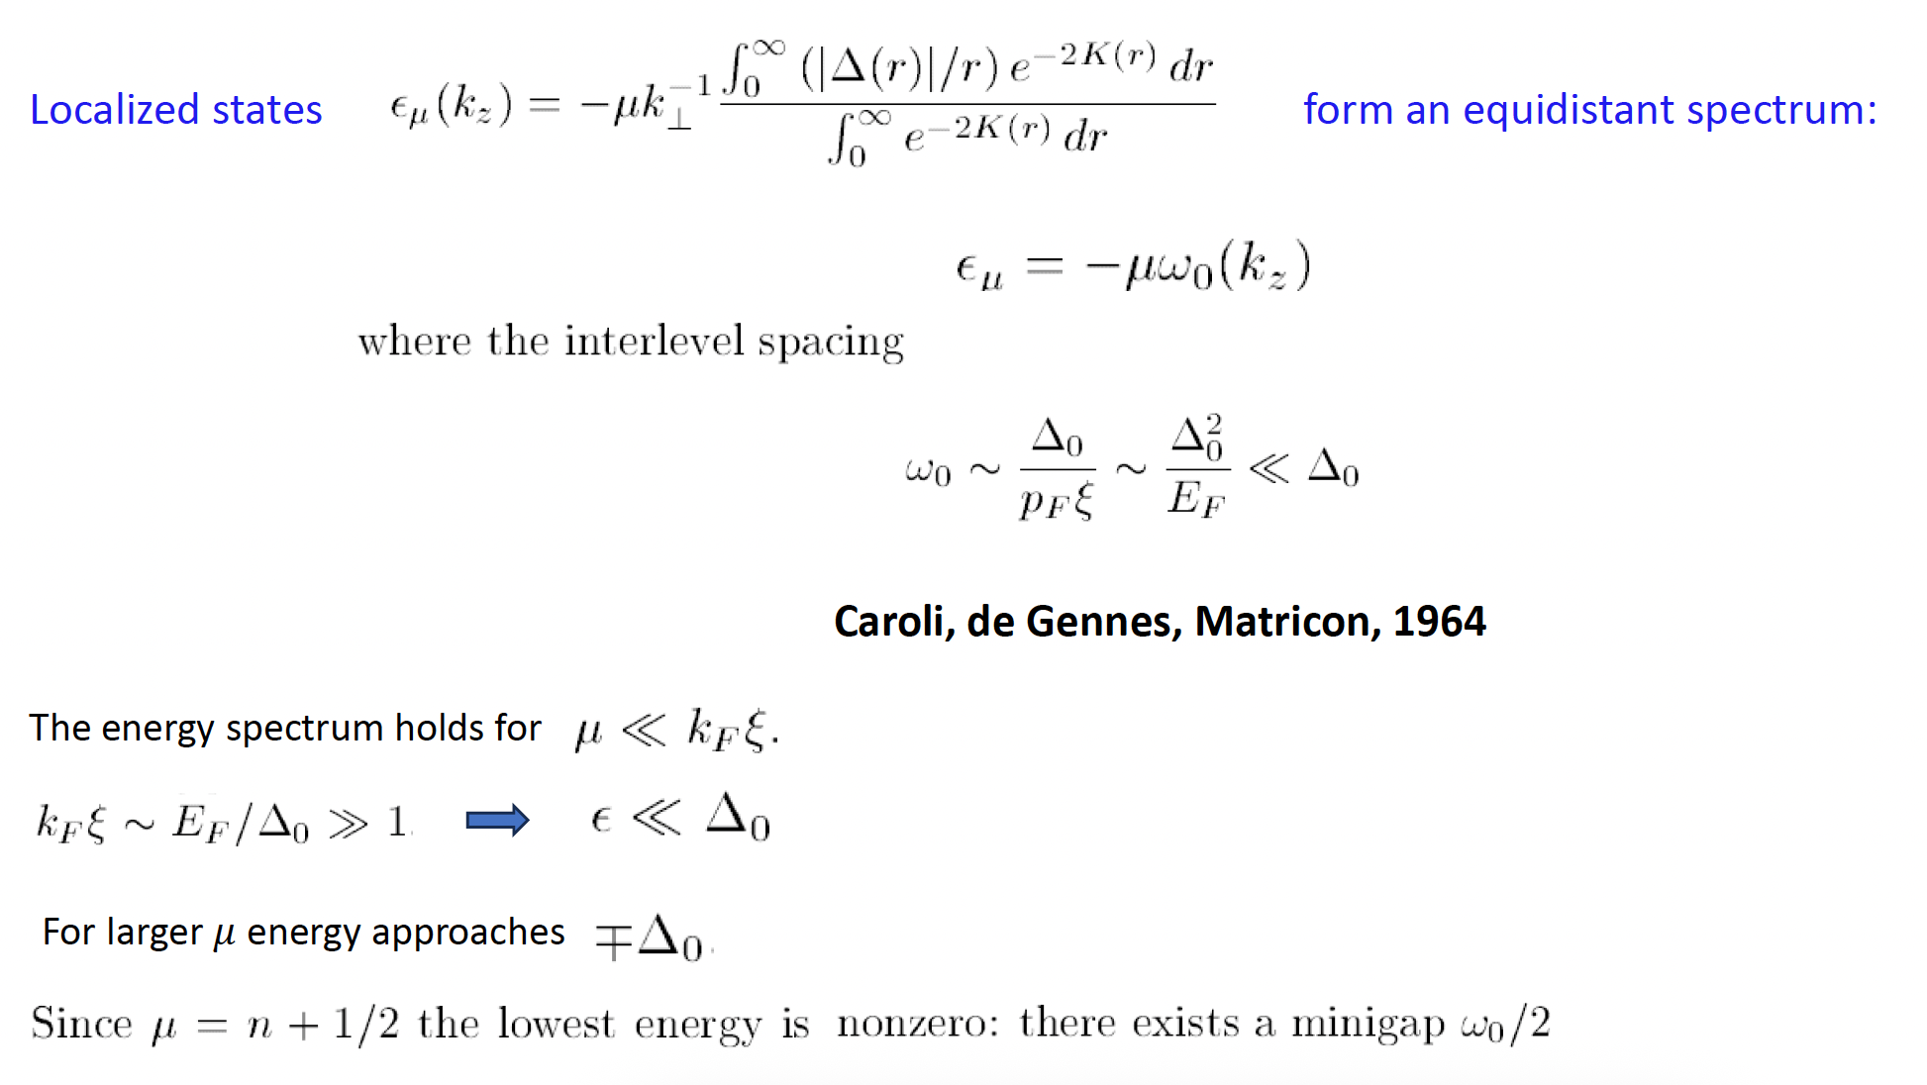
Andreev states: vortex core states

Slide 22
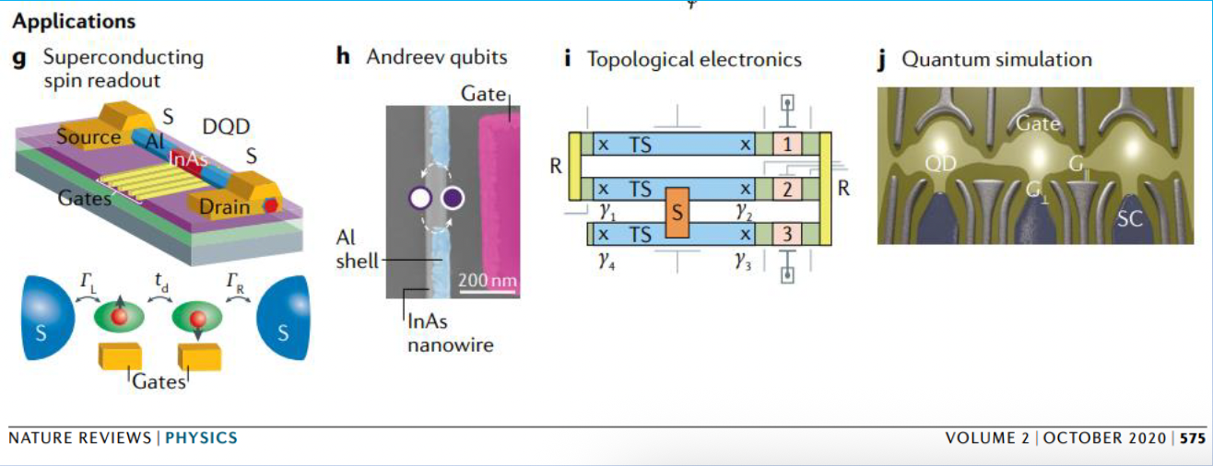

Slide 23
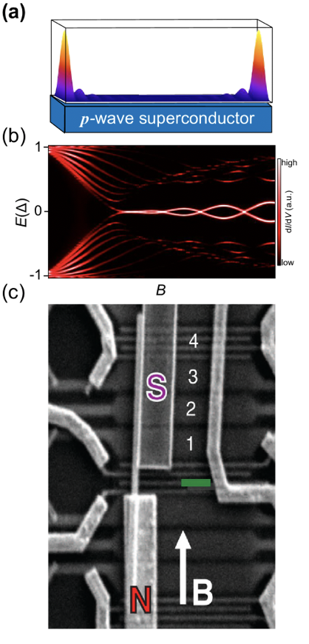
Sub-gap bound states in superconducting systems
Schematic of Majorana wave function in a spinless one-dimensional p-wave superconductor. The wave function demonstrates an end-to-end nonlocal distribution.
Calculated spectrum of sub-gap state in a Majorana wire, as a function of the magnetic field. Majorana zero-mode emerges as the superconducting gap closes and reopens at the phase transition point.
Scanning-electron-microscope image of a superconductor-semiconductor nanowire device. We saw last week!

Slide 24
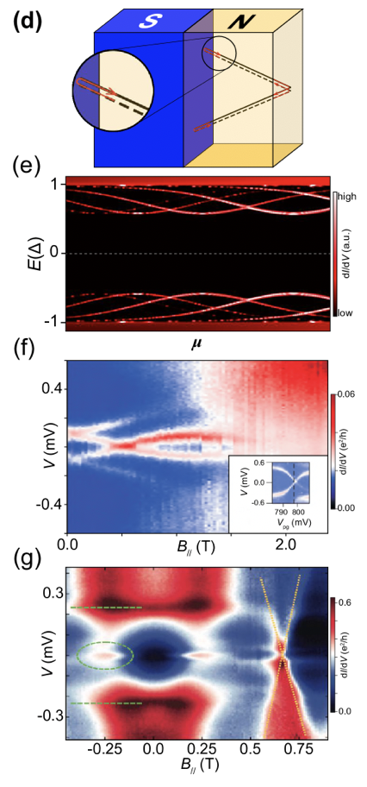
Sub-gap bound states in superconducting systems
Schematic of the formation of the Andreev bound state.
Calculated spectrum of trivial Andreev bound states in a one-dimensional superconductor-semiconductor system.
Measured trivial Andreev bound state spectrum evolving in the magnetic field.
Measured zero-energy conductance peak as a signature of Majorana-bound state.

Slide 25
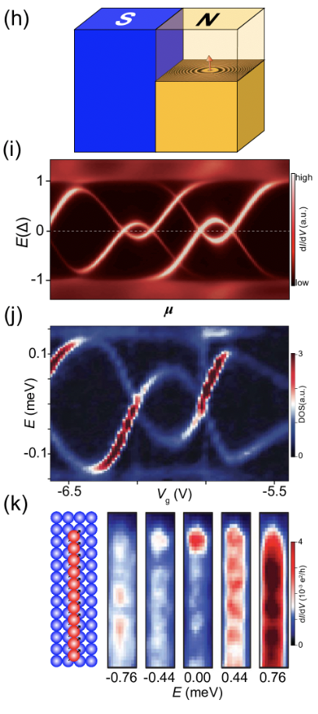
Sub-gap bound states in superconducting systems
Schematic of Yu-Shiba-Rusinov sub-gap states in a superconducting-magnetic impurity system.
Calculated a trivial Yu-Shiba-Rusinov state in a spinful Josephson quantum dot setup.
Measured the trivial Yu-Shiba-Rusinov spectrum in a carbon nanotube quantum dot sandwiched by two superconductor leads.
Scanning-tunneling-microscope spectrum of a ferromagnetic Yu-Shiba-Rusinov chain on a superconductor, where a zero-energy state located at the chain end is visible.

Slide 26
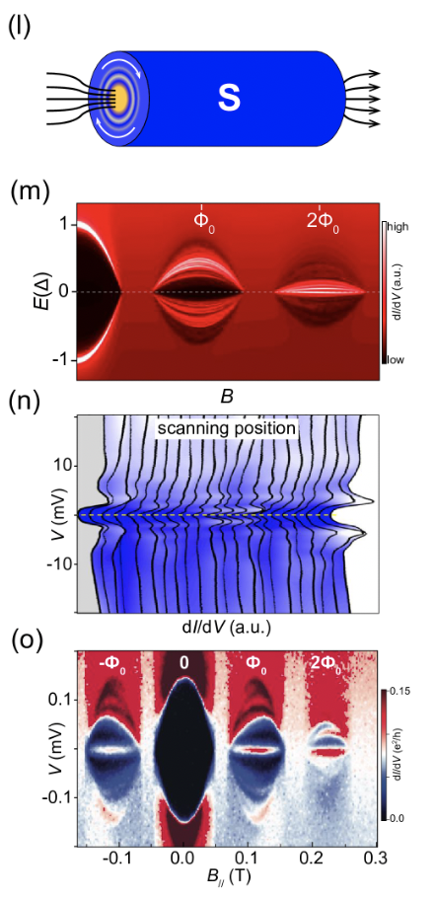
Sub-gap bound states in superconducting systems
Schematic of the vortex Caroli-de Gennes-Matricon state.
Calculated spectrum of trivial Caroli-de Gennes-Matricon states for a semiconductor-superconductor core-shell model.
Measured trivial Caroli-de Gennes-Matricon vortex states in a high-Tc superconductor.
Measured vortex-bound state spectrum of a semiconductor-superconductor core-shell nanowire, where a zero-energy state appears with an odd winding number.

Slide 27
Quantization of Majorana conductance
To understand the quantized Majorana conductance, let’s recall a normal mesoscopic conductor with a nanoscale constriction (the so-called quantum point contact), where the conductance will be quantized to 2ne²/h (with n=0,1,2,3,…).
If the QPC is replaced by two tunneling barriers that are closely separated, unity transmission occurs when the two barriers have equal transmission. In the perfect resonant regime, quantized conductance can also be achieved at resonance points.
The perfect resonant tunneling is anticipated to always happen at the boundary of a normal lead and a Majorana zero-mode, giving rise to a quantized conductance.
The symmetric particle-hole nature of the Majorana zero-mode guarantees the equality between the transmission of the incoming particles (holes) to the lead and the transmission of the Andreev-conjugated holes (particles) to the same lead.
Ballistic Andreev reflection will lead to a 4e²/h tunneling conductance for each spin-degenerate mode (the BTK model)
For Majorana Majorana-bound state, the spin degeneracy is lifted, and therefore the quantized Majorana conductance is 2e²/h.
This conductance should remain precisely quantized even with disorders!!

Slide 28
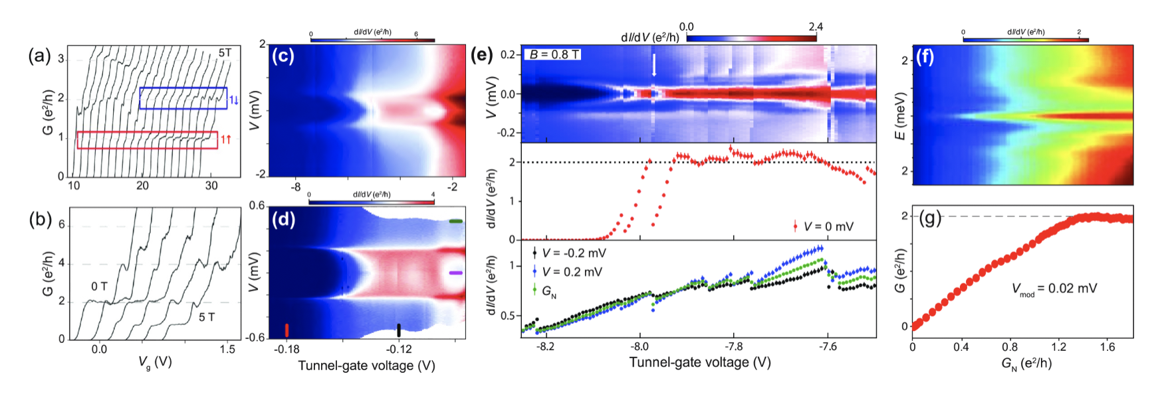
Quantization of Majorana conductance
In a practical experiment, the one-to-one correspondence between quantized conductance and Majorana bound state is unfortunately ambiguous. On the one hand, the tunnel barrier with a faulty profile, the temperature broadening effect, the multi-band effect, and other dissipations will all cause reductions to the quantized conductance in Majorana point contact structure. On the other hand, a zero-energy state with a mundane origin is also possible to give a seemingly quantized conductance plateau along with a single tuning parameter. Hence, the robustness of the quantized conductance has to be checked in high-dimensional parameter space.

Slide 29
Majorana oscillations
However, quantized Majorana conductance requires the pair of Majorana modes to be sufficiently separated. This is because an overlap will cause the finite energy splitting, which removes the particle-hole symmetry resulting from the zero-energy property of Majorana. Transparency-independent quantized conductance plateau is thus a piece of substantial evidence for the Majorana zero-mode.
Interestingly, nearly quantized conductance plateaus have been reported in a different but relevant system, i.e., vortex zero modes in iron-based superconductors. Emergent zero-energy modes in the cores of ferromagnetic-superconductor vortices are probed by a scanning-tunneling-microscopy tip. The tunneling transmission can be varied by adjusting the tip-sample distance. As the tunneling conductance above the gap increases, the peak height of the zero-energy vortex mode is found to saturate at a value that is close to or equal to 2e²/h.

Slide 30
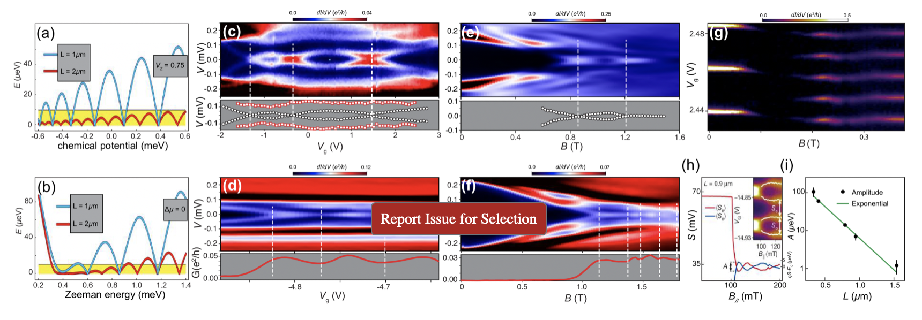
Majorana oscillations
(a) and (b) Calculated oscillations of Majorana modes with chemical potential and Zeeman field, respectively.
(c) and (d) Measured sub-gap bound states in epitaxial InAs/Al nanowires, with oscillating energy and conductance as a function of gate voltage. (e) and (f) oscillating with the magnetic field.
(g)-(i) Measured Majorana-island geometry data. The energy of the lowest sub-gap state can be extracted via the peak-to-peak distance. The energy oscillation of the sub-gap bound states shows an exponential decay as the island length increases.

Slide 31
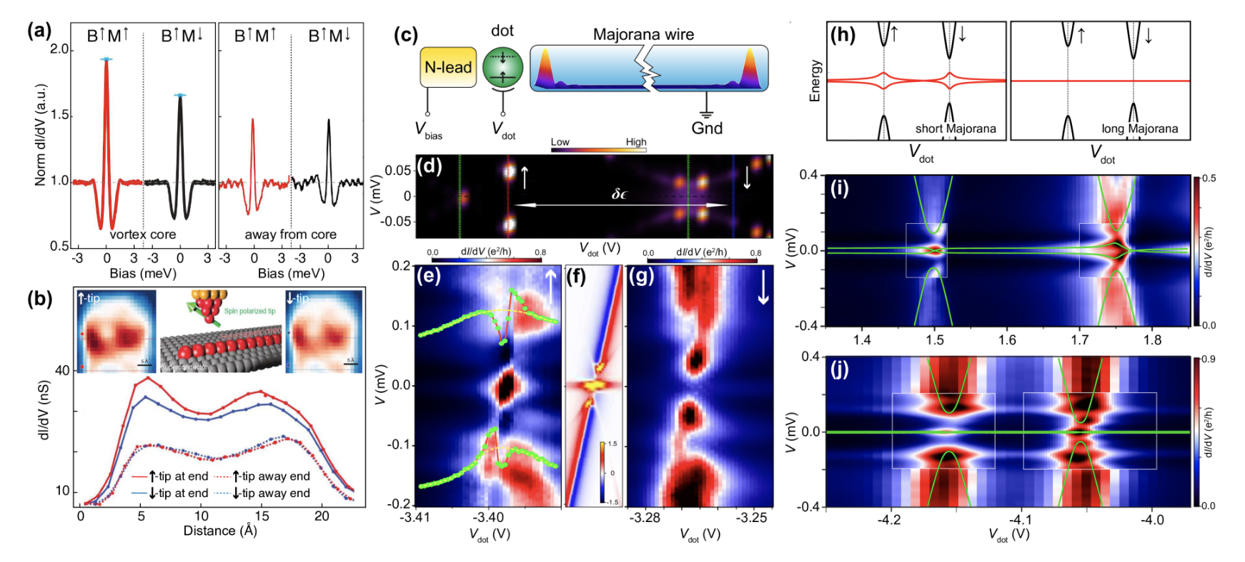
Interacting Majorana with extra degrees of freedom
(a) Spin-selective Andreev reflection evidence observed in vortices of Bi₂Te₃/NbSe₂ heterostructure.
(b) Spin-resolved zero-energy states as a signature of Majorana modes in a ferromagnet chain on a superconductor substrate.
(e) Measured resonance tunneling between a spin-up dot level and the sub-gap states in an InAs/Al hybrid nanowire.
(i) and (j) Measured conductance stability diagram of coupled quantum dot-InAs/Al nanowire device.

